Slide 1
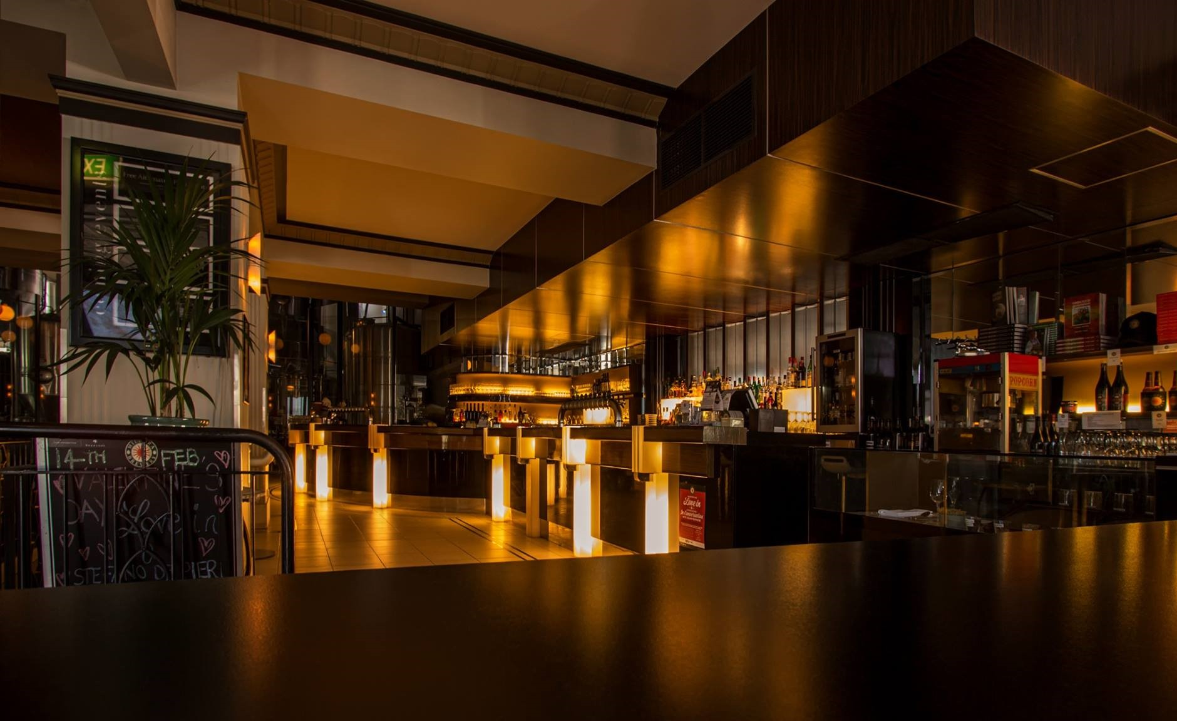
HOTEL MANAGEMENT SYSTEM

Slide 2


Presented by –
K .Venkatesh AP21110010933
D . Srinadh AP21110010951
G . Dhakshayani AP21110010930
Chandan Shah AP21110010934
This Photo by Unknown Author is licensed under CC BY-NC

Slide 3

AGENDA
Introduction
Aim of the Project
Abstract
Project Implementation Process
a) Technology Used
b) Features
c) Methodology
Source Code
Output Screenshots
Conclusion
Future work
References

Slide 4

Introduction
Almost all people travel around the world and not all have home around the world so they will prefer to live in hotels.
This is a huge task for the staffs in hotel as a lot of data of the customers need to be stored properly and efficiently.
Implementing a system which can handle all the information about the hotel guest along with the needed facilities all under one system would help the staffs of the hotel.
The system will be optimized to add, modify the details about customer with what facilities they want to add as food, laundry and more.
Humans tend to make simple errors like calculating the total bill of a hotel guest can have a huge impact on small hotels, so with the help of my project ‘DVCS’ Hotel will not have such problems and the database will be safe as well.

Slide 5

Aim of the project
The main aim of this project is to fabricate a web application for lodgings around the world, however concentrating more on India as this is the new innovation here. The system will deal with all the fundamental services done by the hotel, however the online frame work like room booking, checking for room info, restaurant menu and ordering food, payment online or offline.
The system won't be huge, however if necessary in future, more exertion and work should be possible to cause it to develop regarding usefulness and usability.

Slide 6

Abstract
The Hotel Management System is one of the best sources for all stages of people as they provide detailed information about the rooms, food service, management, etc. The hotel management project is not an easy task because we develop more than 100 modules for implementation.
Let’s Talk about the features of this Simple Hotel Management System using Python, at first, the user has to enter their data. It includes the Full Name of the user, check-in, User’s Address, check-out dates. simple system also contains other functions .
This system teaches us how we can manage a hotel, restaurant, etc.,
It is a user friendly and very easy to use. We have created this project based on the knowledge gained about Python programming so far.
Hotel Management System is a desktop application software system where the management of entire hotel is computerized.
This project is very useful and can be helpful to many people.

Slide 7


Project Implementation
a) Technology Used:
Language: Python
IDLE : Python IDLE
Operating System : Windows 11
Processors : Intel Core i5 processor
Disk space : 3 to 4 GB.
Python Version : Python 3.9. 8

Slide 8

FEATURES
It inputs the following features in our project
Booking of Hotel
Rooms info required
Restaurant (Food)
Payment method
Record book
Exit

Slide 9

Methodology
Concept of functions is used in this project
Functions Created
Home() - Function to display the project’s main screen i.e. the home page of the project or you can say the main menu for selecting the desired operation to perform.
Date (str) - Function to validate date entered by the user/customer.
Booking () - Function for booking room in hotel by entering user/customer details.
Room Info() - Function to provide users/customers with hotel rooms information(i.e. about room amenities).
Restaurant () - Function for room service which provides user/customer with the restaurant’s menu card to order food at the room.
Payment () - Function for payment of hotel room and restaurant bill generation at the time of check-out.
Record () - Function for keeping records of customers stayed in the hotel

Slide 10

Conclusion
At this moment on the world everything is going computerized from small things to huge things which has brought a huge change on our lives.
A few years ago computer was not even considered as an essential but just a rich person’s toy but the time has changed and as we all know it has a huge impact on our lives.
Huge companies like Apple, Microsoft and many others companies all are investing to make a better future with efficiency.
Tourism has boosted all around the world and hotels need to manage their data properly . Major parts of the world need to manage their customers as anything can happen and even data which were over a decade ago can have a huge impact on some cases.
A person often makes some mistakes and with a proper management system those error will be deleted. Data will be stored properly and bills with some features with of the hotel can be added easily without any errors.

Slide 11



